Slide 1
Introduction to the Windows 10 Universal Windows Platform Developer’s Guide to Windows 10

Slide 2

The convergence journey
Xbox 360
Xbox One
Unified core and app platform
Converged
OS kernel
Windows 8.1
Windows 8
Converged
app model
Windows 10
Windows Phone 8.1
Windows Phone 8
Easy for users to get & stay current
Windows Phone 7.5
Windows on Devices

Slide 3
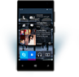

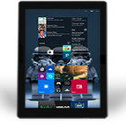
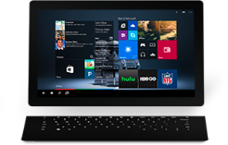

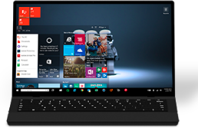

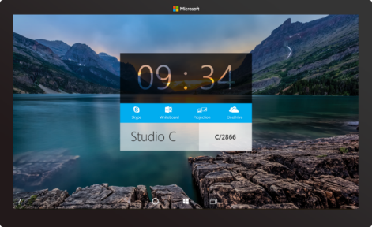

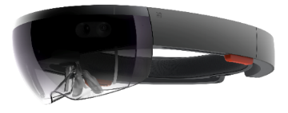



2-in-1s (Tablet or Laptop)
Classic Laptop
Desktops & All-in-Ones
Phone
Phablet
Small Tablet
Large Tablet
Windows 10
Surface Hub
Xbox
Holographic
IoT

Slide 4
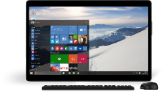
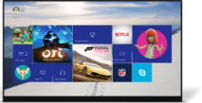
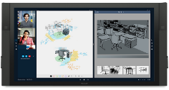
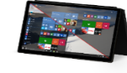
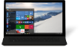
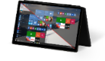
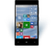
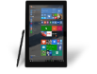
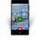











PC
XBox
Mobile
Surface Hub
Devices +IoT
HoloLens
Universal Apps
Multiple device families
Adaptive User Interface
Reuse Existing Code
Natural User Inputs
One Store + One Dev Center
One SDK + Tooling
One Universal Windows Platform

Slide 5
WPF
WF
MFC
XAML
HTML
Bridging technologies
Obj.C
iOS
Java
Android
Web
hosted
Win32
desktop
DirectX
.Net
languages
C++
.Net
languages
C++
& CX
WWA
.Net
runtime
Universal Windows Platform
Windows 10
operating system

Slide 6
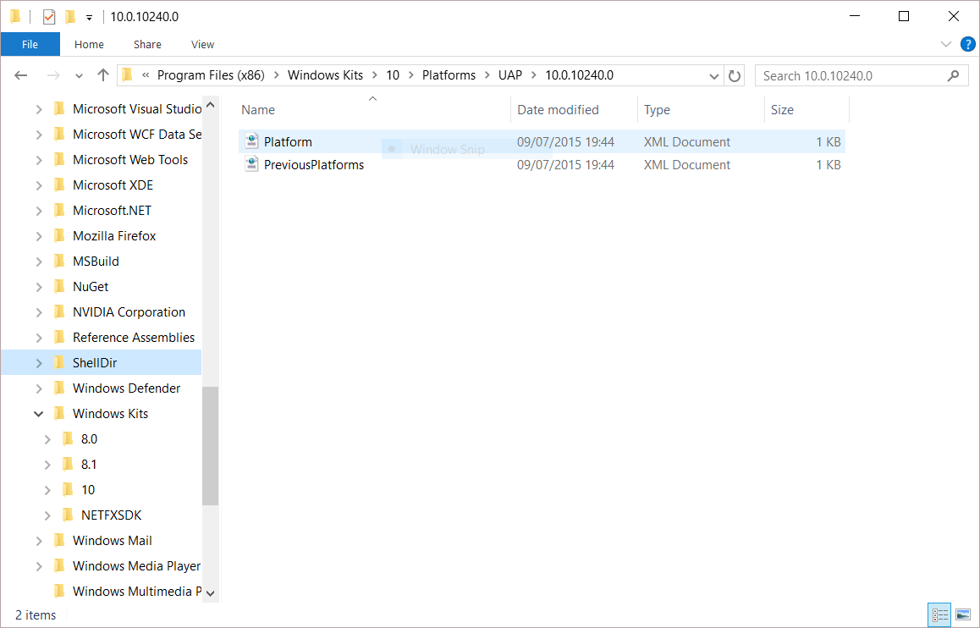
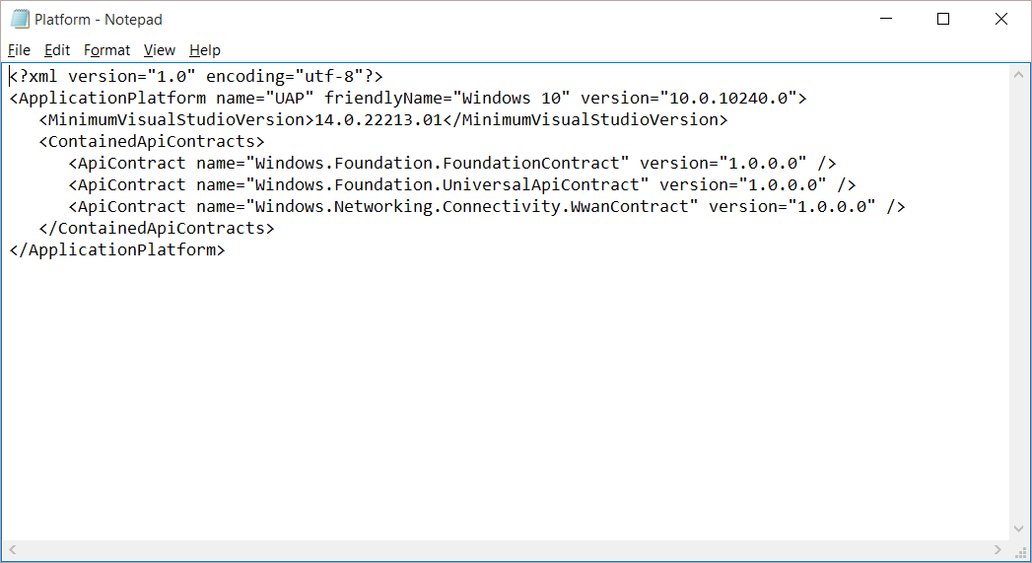
Universal Windows Platform
A single API surface
A guaranteed API surface
The same on all devices
Universal Windows Platform
Windows Core
Desktop
Device
Phone
Device
Xbox
Device

Slide 7
A whole lot of APIs…
Storage
DirectX 12
Speech and Cortana
Networking
NFC and Bluetooth
Holographic
Audio and Video
Appointments/Calendar
Authentication Broker
Background Transfer
Maps and Location
Sensors: Accelerometer, light, magnet …
Tiles and Notifications
App to App and App Services
Inking
XAML
Background Tasks
Data Roaming
Data.XML
Media Casting
Many, many more….

Slide 8
Apps don't target Windows 10, apps target the UWP

Slide 9
<Dependencies>
<TargetDeviceFamily
Name="Windows.Universal"
MinVersion="10.0.10240.0"
MaxVersionTested="10.5.0.0"/>
</Dependencies>

Slide 10
The Universal Windows Platform can update at its own cadence

Slide 11
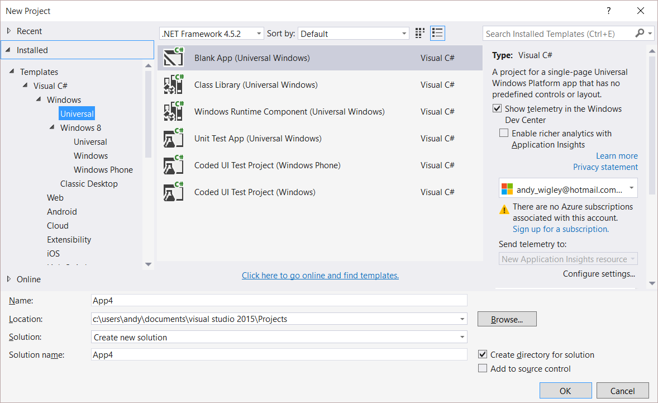
Windows app
A single binary
Running on any device
Testing for capabilities
Adjusting to devices
Windows App
Universal Windows Platform
Windows Core
Desktop
Device
Phone
Device
Xbox
Device

Slide 12
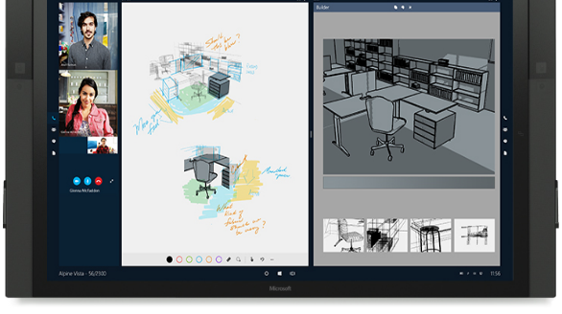
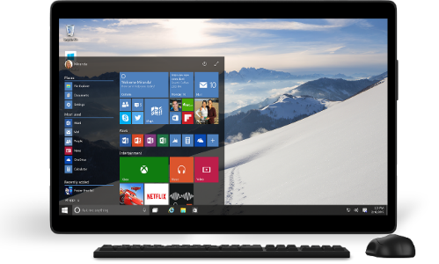
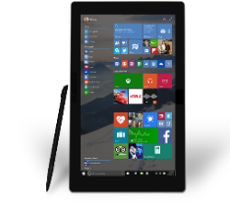

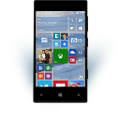

Universal Windows Platform
One Operating System
One Windows core for all devices
One App Platform
Apps run across every family
One Dev Center
Single submission flow and dashboard
One Store
Global reach, local monetization Consumers, Business & Education

Slide 13
One Windows
Desktop SKU
Mobile SKU
Xbox SKU
IoT SKU
IoT headless SKU
Surface Hub SKU
Holographic SKU
PC
2 in 1
Tablet
Phablet
Phone
Xbox
Band
Raspberry Pi
Surface Hub
HoloLens
Home Automation

Slide 14
Each family offers its own shell and adds features to those it inherits

Slide 15
Adaptive UI

Slide 16
Adaptive design
Responsive design
Flexible layout responds to small changes
Many controls handle basic responsiveness
Adaptive design
Smart layout adjusts to large changes
Features like visual states aid in this design
Tailored design
A device-specific app can simplify design
Some devices have unique design languages

Slide 17
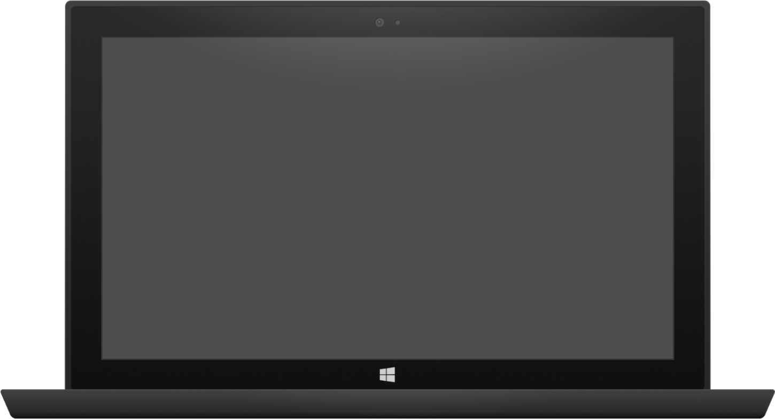

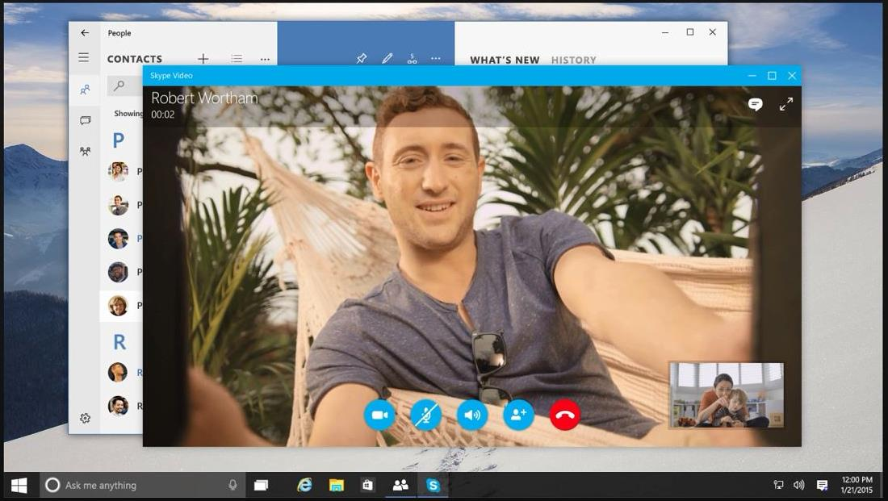

Adaptive design
Tablet (landscape) / Desktop
Phone (portrait)

Slide 18
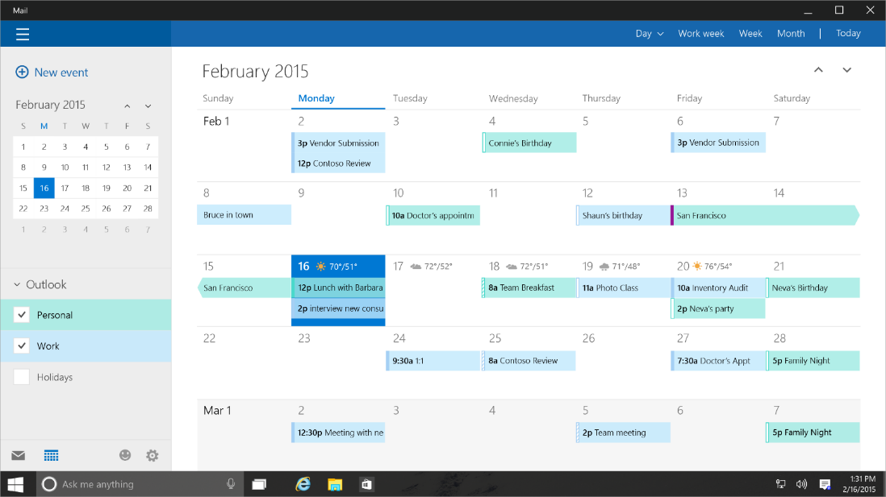
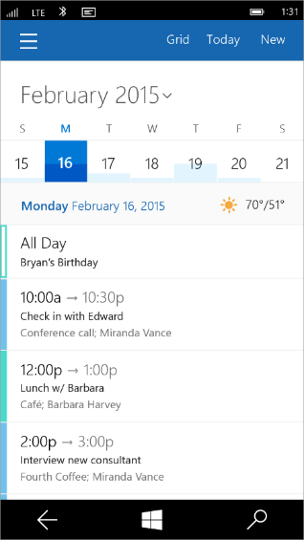
Tailored design
Tablet (landscape) / Desktop
Phone (portrait)

Slide 19
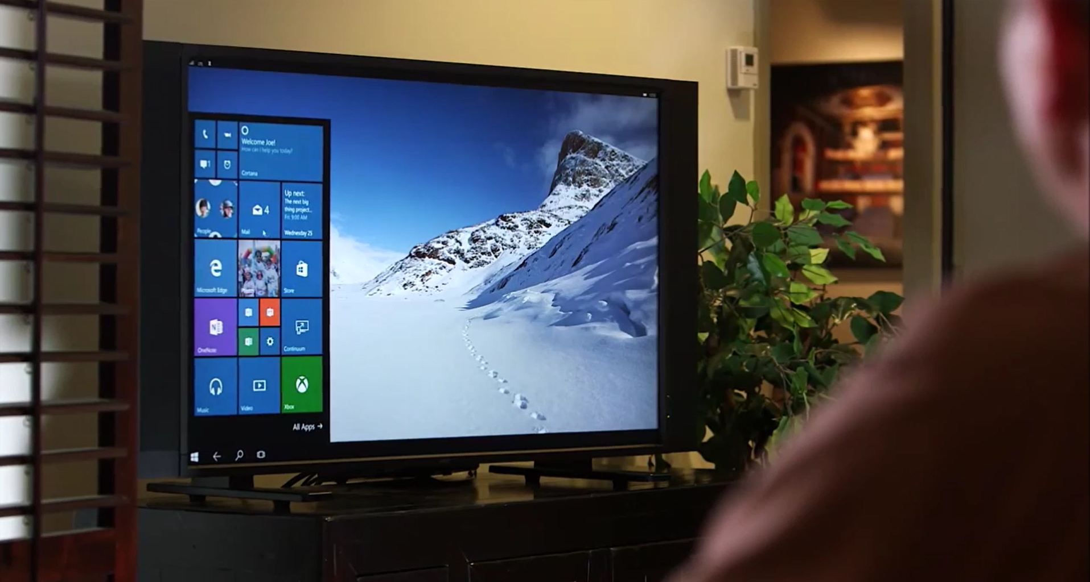
Continuum for Convertibles and Phones
Continuum for convertibles and Phones

Slide 20
Users love apps that give a great experience on all their devices

Slide 21
Adaptive code

Slide 22
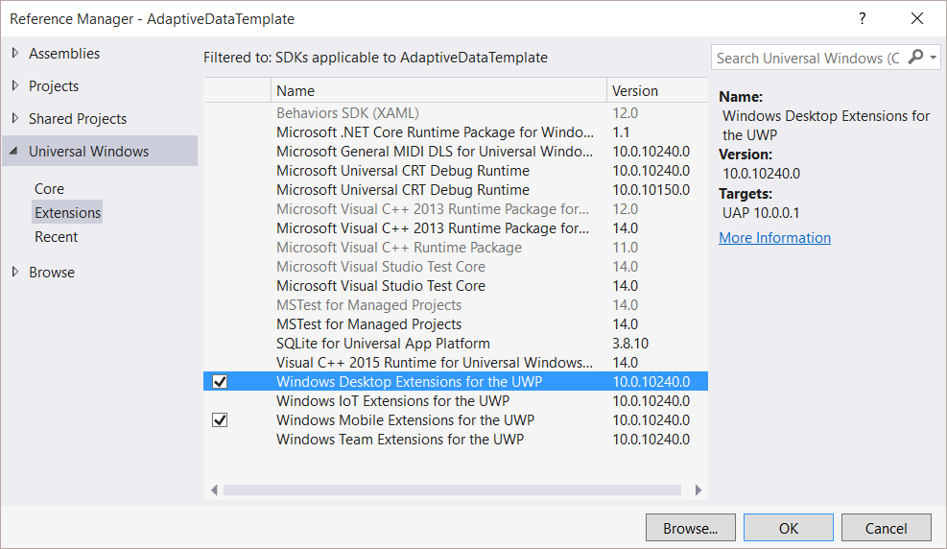
Platform extensions
Device-specific API
Family-specific capabilities
Compatible across devices
Unique update cadence
Windows App
Desktop
extension
Phone
extension
Xbox
extension
Universal Windows Platform
Windows Core
Desktop
Device
Phone
Device
Xbox
Device

Slide 23
UWP
UWP
UWP
UWP
Windows Core
Windows Core
Windows Core
Windows Core
Desktop
Mobile
Xbox
More…

Slide 24
Test capabilities at runtime
Use Adaptive Code to light-up our app with capabilities on specific device families
Testing for capabilities and namespaces
var api = "Windows.Phone.UI.Input.HardwareButtons";
if (Windows.Foundation.Metadata.ApiInformation.IsTypePresent(api))
{
Windows.Phone.UI.Input.HardwareButtons.CameraPressed += CameraButtonPressed;
}

Slide 25
Microsoft Edge and Web Platform

Slide 26

Microsoft EdgeHTML
Microsoft Edge
JS Symbols
ES6 Numbers Built-Ins
DOM L3 XPath
Rest parameters
4200+ interoperability improvements
ES6 Template Strings
Arrow function
asm.js
JS iterators
<img srcset>
Web Audio API
ES6 classes
GamePad API
Content Security Policy
Video tracks
ES6 Promises
Selection API
ES6 Math Built-Ins
HTTP Strict Transport Security
Touch Events
Media Queries L4 Interaction Media
ES6 String Built-Ins
ES6 WeakSet
getUserMedia()
ES6 Spread
preserve-3d
ES6 Proxies
ES6 Object Built-Ins
HTTP/2
WAV audio
HTTP Live Streaming
Date <input> types
Motion JPEG
Generators

Slide 27
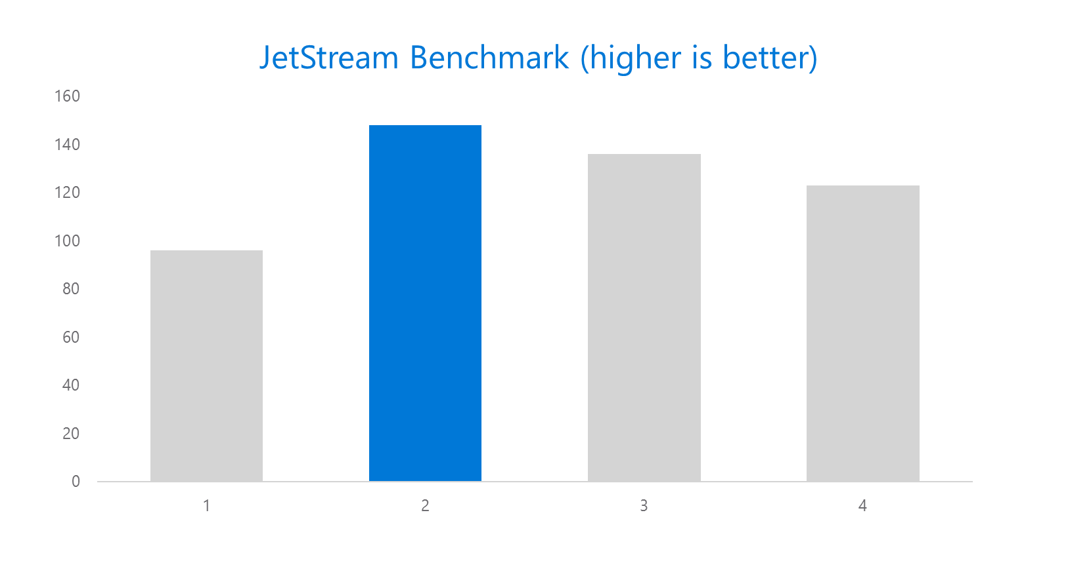
Microsoft Edge

Slide 28
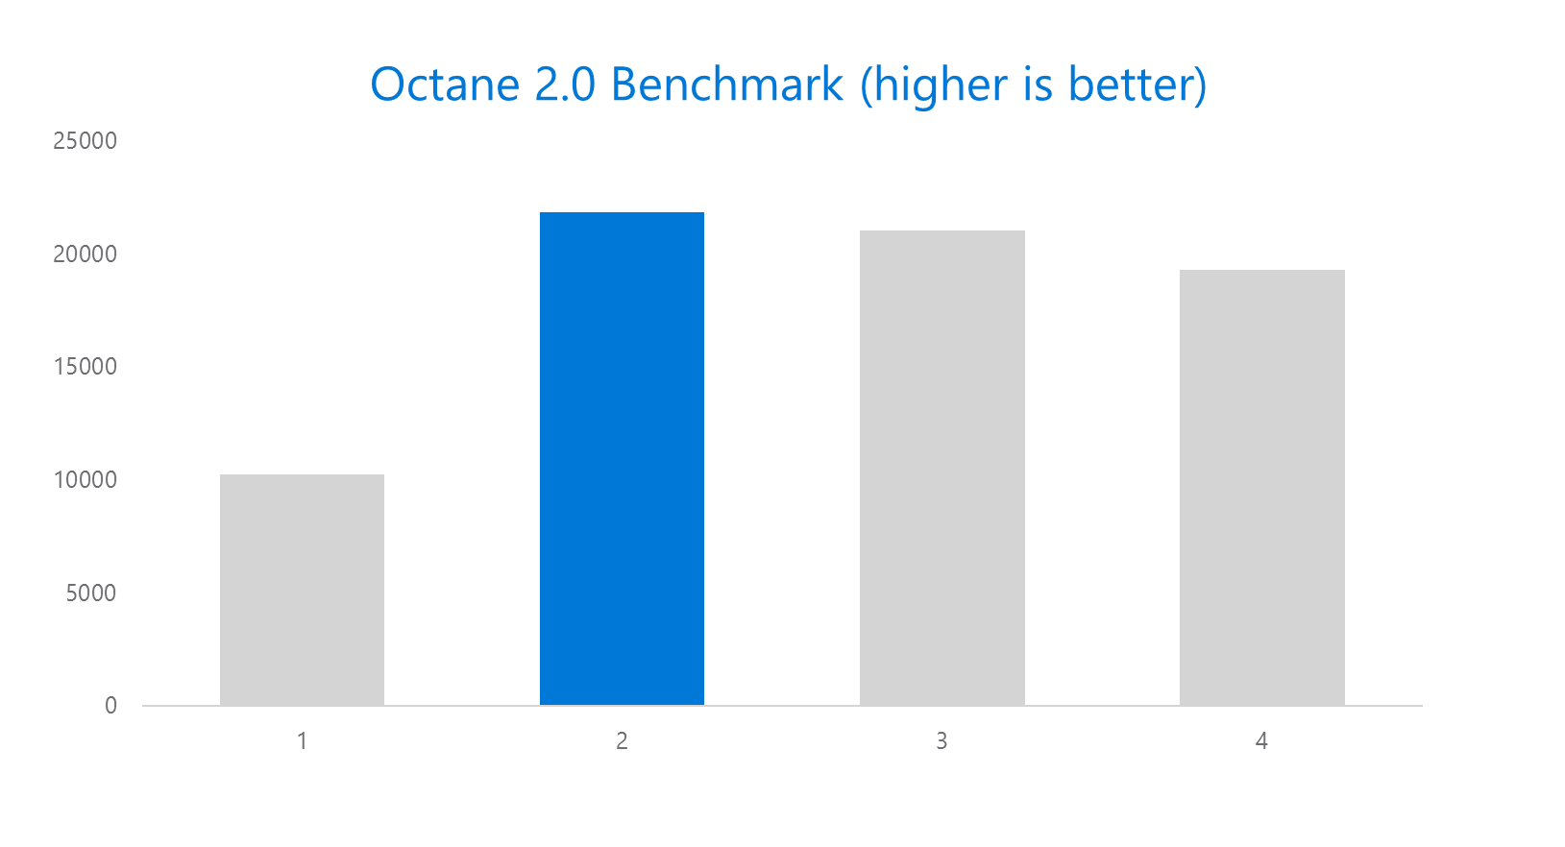
Microsoft Edge

Slide 29
Bridging Technologies

Slide 30
Web Apps
pp
NEW: Hosted Web Apps
Bring your website experience to the Windows Store
Leverage your web investments and developer workflow
Full access to Universal APIs, including
Tiles, Notifications, Camera, Contact List, Calendar
.appx
HTML
CSS
JS
Universal Windows Platform

Slide 31
Windows Bridge for Android (a.k.a. Project Astoria)
Tooling to allow apps written for Android™ to run on Windows 10 Mobile with few changes required
Microsoft Interoperability library redirects calls to Google services to Microsoft services
Submit .apk to the Store
Extend to call subset of UWP APIs
Tiles and Notifications
Sign up for limited developer preview at http://uwp.dev.windows.com/en-US/uwp-bridges/android

Slide 32
Windows Bridge for iOS (previously known as ‘Project Islandwood’)
Build Universal Windows Apps using Objective-C
Import Xcode® projects into Visual Studio
Build and debug your Objective-C code from Visual Studio
Take advantage of great Windows services
Extend your app to take advantage of Universal Windows Platform features
Get the Developer Preview:
https://dev.windows.com/en-us/uwp-bridges/ios
Code is open source:
https://github.com/Microsoft/WinObjC/

Slide 33
Project Centennial
Package and publish existing .NET and Win32-based Windows applications to the Windows Store
Use Centennial to call common UWP APIs and services
More information coming soon…

Slide 34
Development tools

Slide 35
Visual Studio 2015 Editions
Enterprise
Architecture Modeling, Diagnostics, VSO/ALM & Release Management
Professional
Architecture Validation, VSO/ALM & Feedback Management
Community Editions
Visual Studio Professional Edition

Slide 36
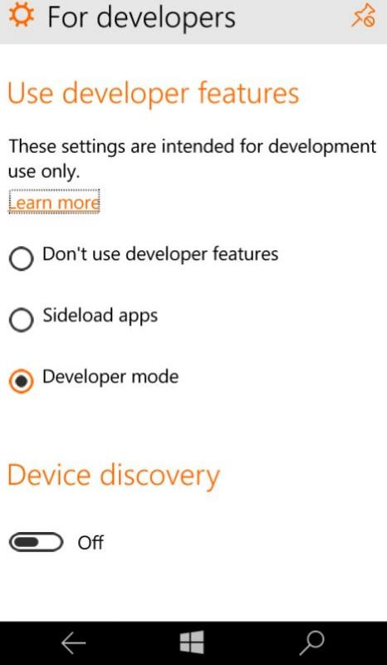
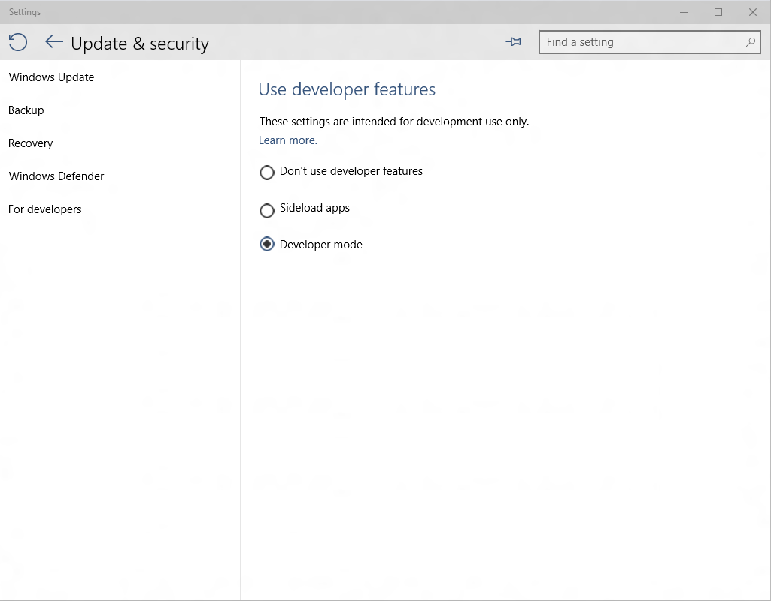
Developer unlock

Slide 37

Where can I develop?
Windows 10
Requires Visual Studio 2015
Windows 8.1 & Windows Server 2012 R2
The Visual Studio designer does not function
Debugging requires a Windows 10 device or Remote Debugging Tools

Slide 38
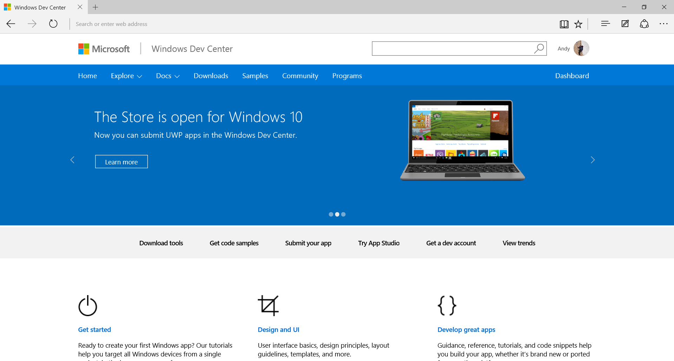
dev.windows.com

Slide 39
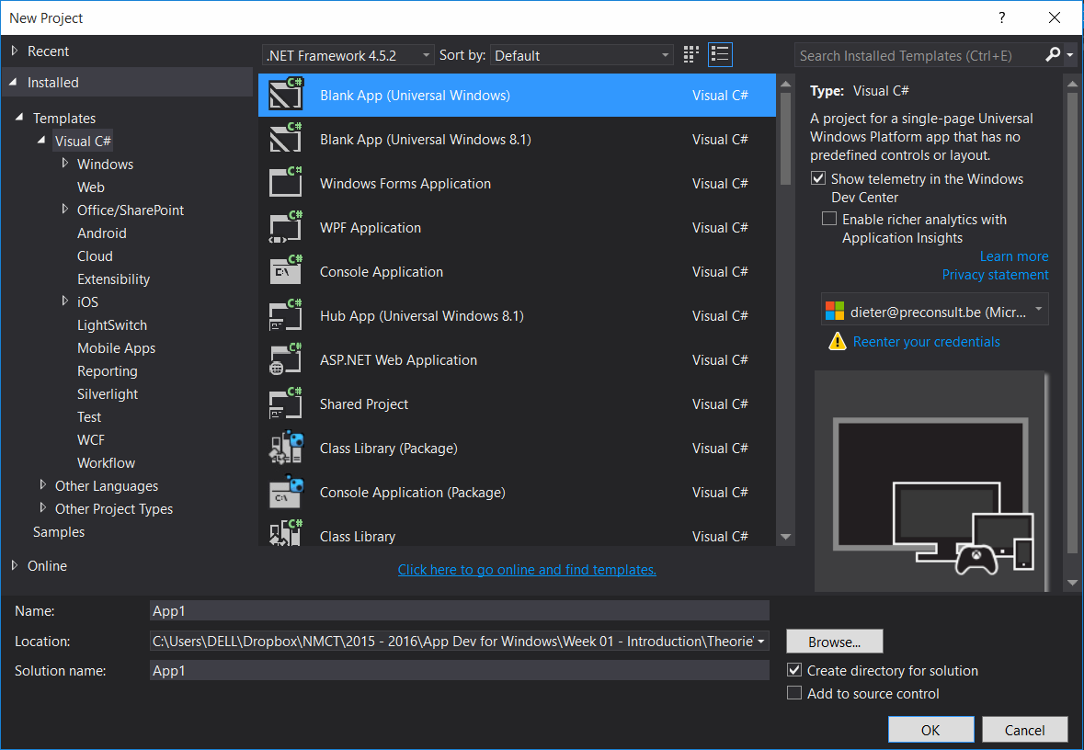
Project Structure

Slide 40
Project Structure
Nuget 3.0
New version
project.json
Contains used nuget packages

Slide 41
Project Structure
App.xaml/App.xaml.cs
Application startup file
Contains suspending logic

Slide 42
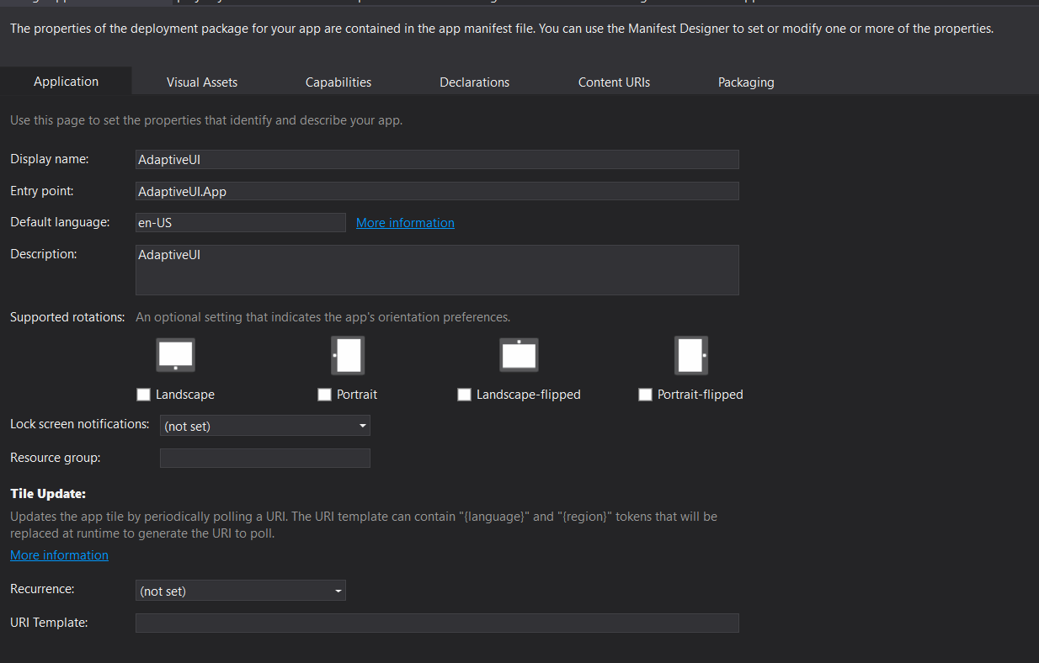
Project Structure
Package.appxmanifest

Slide 43
Controls in the XAML toolbox

Slide 44


Adaptive controls

Slide 45


Input intelligence

Slide 46
Using standard controls gets you a long way

Slide 47
Layout controls
Windows XAML layout controls
Stack Panel
Canvas
Scroll Viewer
Border
Grid
View Box
Wrap Grid
Relative Panel

Slide 48
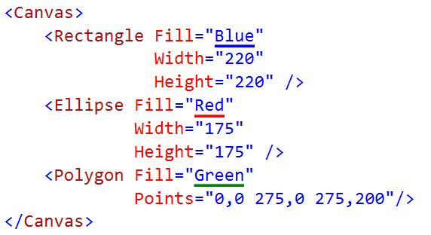

Canvas

Slide 49

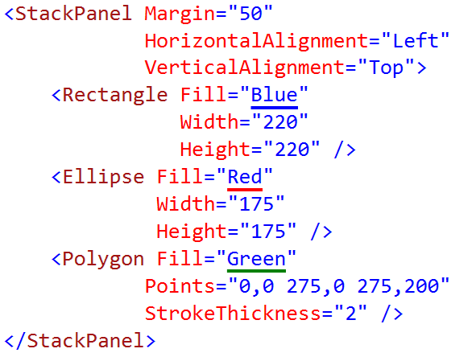
StackPanel

Slide 50
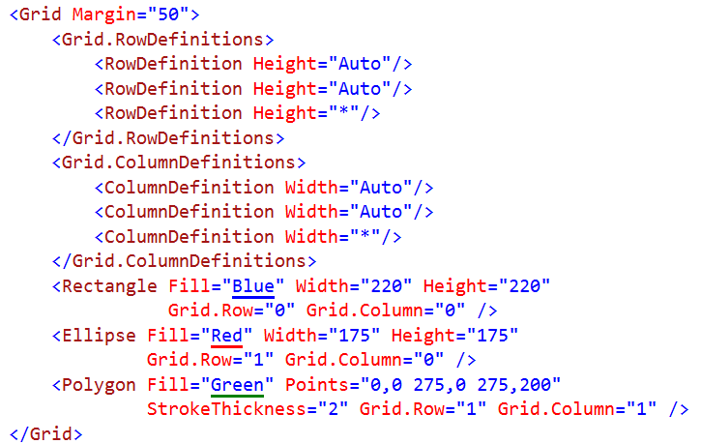
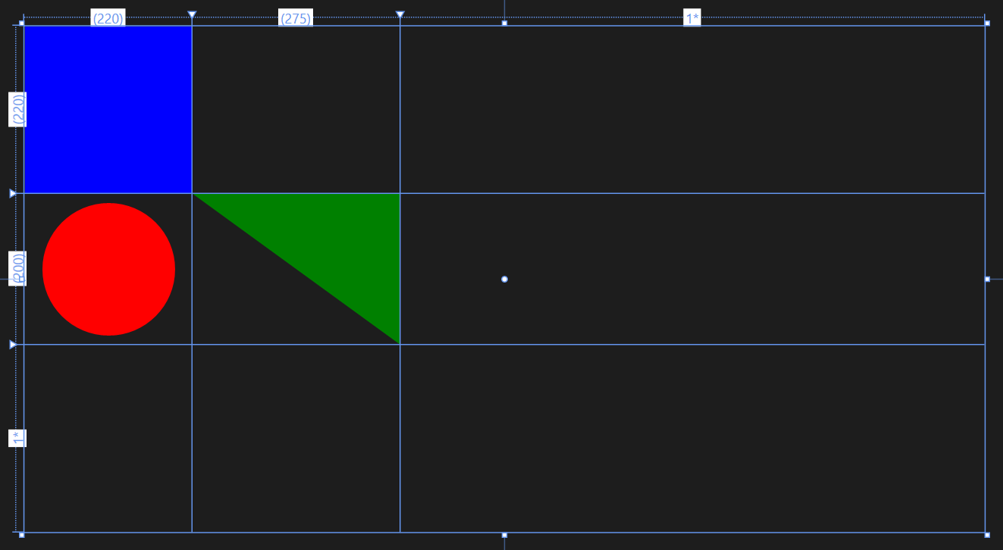
Grid

Slide 51
Proportional layout with Grid
2*
1*
auto
Rows/columns – 3 types of sizing:
star sizing
proportional: 1*/3* = 25%/75%
auto sizing
sized to content
content can also have Max/Min widths and heights as limits
pixel sizing
hard-coded size – avoid in most situations
7*
auto
4*
1*

Slide 52
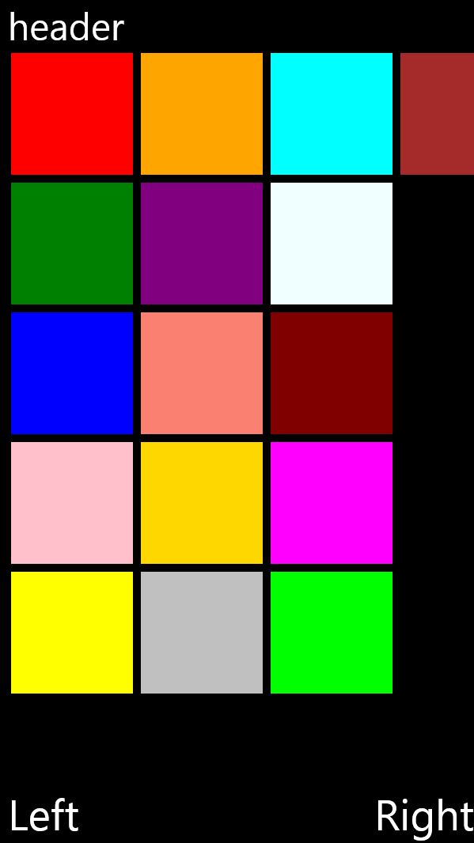
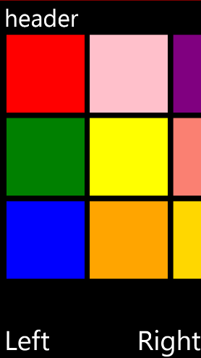
Proportional layout with Grid
600
Grid
400
auto
711
1*
1067
Grid
1*
1*
auto

Slide 53
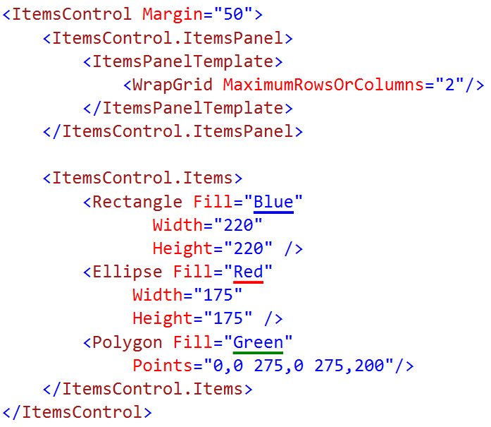
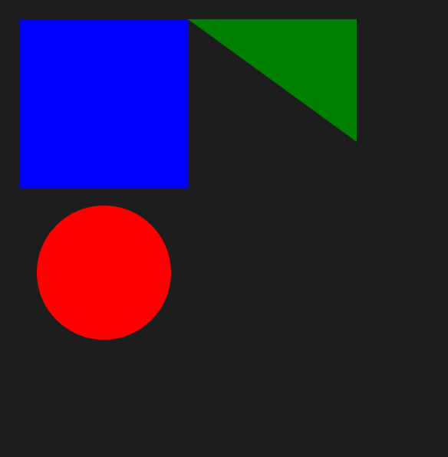
WrapGrid

Slide 54
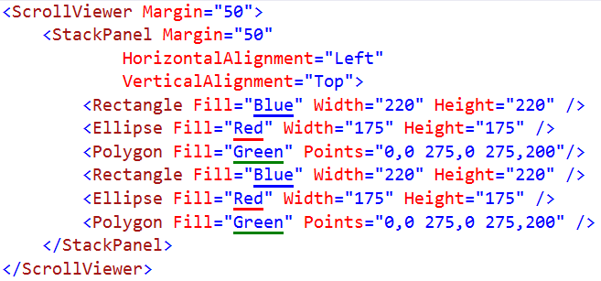

ScrollViewer

Slide 55
Introducing the Relative Panel
Windows XAML layout controls
Stack Panel
Canvas
Scroll Viewer
Border
Grid
View Box
Relative Panel
Wrap Grid
Relative Panel is a XAML layout control. It arranges children by declaring relationships between them.

Slide 56
XAML's RelativePanel control
A child or two act as a anchor elements
They are relative to the panel
Other children are relative to the anchors
RelativePanel.Above = "ElementName"
RelativePanel.RightOf = "ElementName"
RelativePanel.Below = "ElementName"
RelativePanel.LeftOf = "ElementName"
RelativePanel simplifies adaptive UI
A simple Visual State setter can rearrange the UI
One element can move a family of related element

Slide 57
Align with panel
<RelativePanel>
<Rectangle x:Name="RedRect" Height="100" Width="100" Fill="Red"
RelativePanel.AlignHorizontalCenterWithPanel="True" RelativePanel.AlignVerticalCenterWithPanel="True" />
<Rectangle x:Name="BlueRect" Height="100" Width="200" Fill="Blue" />
</RelativePanel>

Slide 58
Align with sibling (below, center)
<RelativePanel>
<Rectangle x:Name="BlueRect" Height="100" Width="100" Fill="Blue" />
<Rectangle x:Name="RedRect" Height="100" Width="100" Fill="Red"
RelativePanel.Below="BlueRect" RelativePanel.AlignHorizontalCenterWith="BlueRect" />
</RelativePanel>

Slide 59
Visual states allow you to define different selectable layouts that can be applied to your UI

Slide 60
How to set the visual state in code
VisualStateManager.Goto(element, state, transition)
public MainPage()
{
this.InitializeComponent();
this.SizeChanged += (s, e) =>
{
var state = "VisualState000min";
if (e.NewSize.Width > 500)
state = "VisualState500min";
else if (e.NewSize.Width > 800)
state = "VisualState800min";
else if (e.NewSize.Width > 1000)
state = "VisualState1000min";
VisualStateManager.GoToState(this, state, true);
};
}

Slide 61
Adaptive triggers
Code-free state transition
Two built-in triggers
MinWindowHeight (Taller than this)
MinWindowWidth (Wider than this)
<VisualState x:Name="VisualState500min">
<VisualState.StateTriggers>
<AdaptiveTrigger MinWindowWidth="501" />
</VisualState.StateTriggers>
</VisualState>

Slide 62
Visual state setters
Setting a simple, scalar value
Great when you think of ENUM values like Visibility, Stretch, etc
Does not invoke a storyboard
Does not require ObjectAnimationUsingKeyFrames
<VisualState.Setters>
<Setter Target="MyText01.FontSize" Value="24" />
<Setter Target="MyImage.Stretch" Value="UniformToFill" />
<Setter Target="MyImage.Height" Value="150" />
</VisualState.Setters>

Slide 63
Demo: RelativePanel & VSM

Slide 64
SplitView
 | IsPaneOpen="True" | IsPaneOpen="False"
DisplayMode= "Inline"
DisplayMode= "Overlay"
DisplayMode= "CompactInline"
DisplayMode= "CompactOverlay"

Slide 65
Demo: SplitView

Slide 66
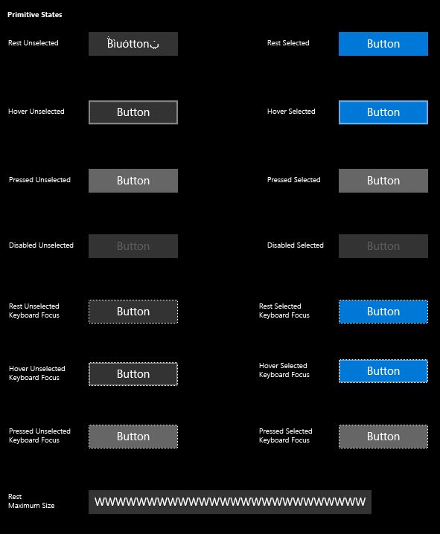
Buttons
<Button Content="" />
<HyperlinkButton />
<RepeatButton />
<ToggleButton IsChecked="" />

Slide 67
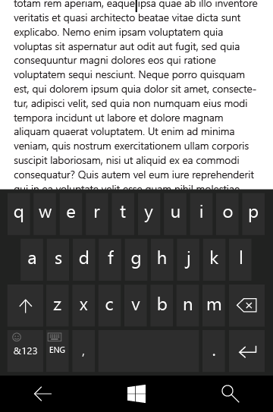
Text controls
<TextBox Text="" />
<PasswordBox Text="" />
<TextBlock Text="" />
<RichEditBox Content="" />
<RichTextBlock Content="" />
<BitmapIcon UriSource="" />
<FontIcon Glyph="" />
<SymbolIcon Icon="" />
<PathIcon Data="" />

Slide 68
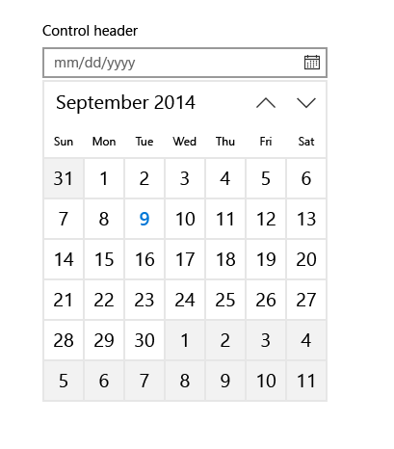
Selection and picker controls
<CalendarView />
<DatePicker Date="" />
<TimePicker Time="" />
<ToggleSwitch IsChecked="" />
<CheckBox IsCHecked="" />
<RadioButton IsChecked="" />
<ComboBox />
<ListBox />
<Slider Minimum="" Maximum="" />

Slide 69
Collection/data controls
<ItemsControl ItemsSource="" />
<FlipView />
<GridView />
<ListView />
<SematicZoom />
<Hub Orientation="" />
<ContentControl ControlTemplate="" />
<DataTemplate />
<ItemsPanelTemplate />
<ControlTemplate />
<ContentPresenter />
<ItemsPresenter />
<ContentControl />

Slide 70
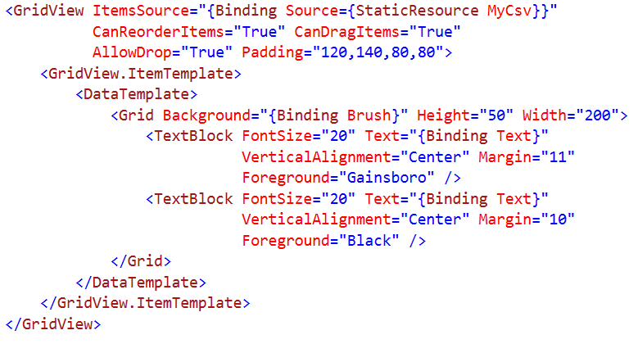
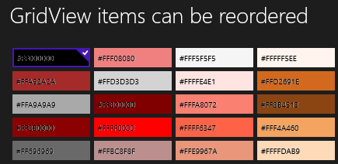
Grid View Syntax

Slide 71
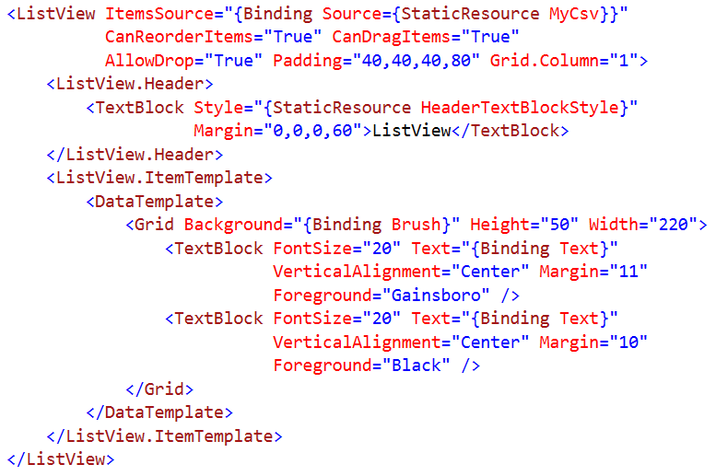

List View Syntax

Slide 72


Flip View Syntax

Slide 73


Hub Syntax

Slide 74

App bars and commands
<AppBar />
<CommandBar />
<AppBarButton Label="" Icon="" />
<AppBarToggleButton IsChecked="" />
<AppBarSeparator />

Slide 75

Flyout controls
<Popup IsOpen="" />
<ContentDialog Title="" Content="" />
<Flyout Placement="" />
<MenuFlyout />
<ToolTip />

Slide 76


ContentDialog
A custom message box to place arbitrary content
Supports both full and partial screen

Slide 77

ContentDialog in XAML
Project -> ‘Add New Item’ -> select ContentDialog
Design your ContentDialog in the same way as a User Control
In code, show your dialog like this:
AboutMessage myDialog = new AboutMessage();
ContentDialogResult result = await myDialog.ShowAsync();
if (result == ContentDialogResult.Primary) { /* do some more Primary logic */ }
else if (result == ContentDialogResult.Secondary)
{ /* else do Secondary logic */ }

Slide 78

Progress, Media & Inking controls
<ProgressBar IsIntermediate="" />
<ProgressRing IsActive="" />
<Image />
<InkCanvas />
<MediaElement />
<CaptureElement />

Slide 79
Resources and Styles

Slide 80
What is a XAML resource?
System resources
ThemeResources
Custom resources
Values (like font size)
Objects (like color brushes)
Control styles
BasedOn
Templates
Control templates
Data templates

Slide 81

Resource Scope

Slide 82


Style Resources for TextBlock
A limited set of Style resources are supplied in the SDK
Suitable for common text display scenarios
Use F12 to examine style definition
You can create your own styles
Use BasedOn to base on a supplied style
Set your own Property Values
Define in App.xaml or in the Page resources

Slide 83


User theme and contrast preferences
On Windows 10, users can select an accent color
You can use this color like this:
On Windows 10 Mobile, also can select Light or Dark mode
Unlike Windows Phone 8.1, your app does not automatically apply the Light or Dark theme
User can also select text size and/or High Contrast
Test your apps to respect these settings
<SolidColorBrush x:Key="AccentBrush" Color="{ThemeResource SystemAccentColor}"/>

Slide 84

Requesting Light or Dark theme
Request the theme for your app in app.xaml:
You can also apply the RequestedTheme attribute to any Page or Control:
<StackPanel RequestedTheme="Light"> … </StackPanel>

